Slide 1

It Innovation & Advantage Team Project – Group 19

Slide 2





Meet the team
Aravind Teja
Mourya
Sohan
Vamsi
Vishnu

Slide 3
TABLE OF CONTENT
Data Set Description
AIRbnb
01
02
Business Problem – 2 & Analysis
04
Business Problem – 1 & Analysis
03
Future SCOPe & CONCLUSION
05

Slide 4

AIRBNB
A web platform where users can rent out their space to host travellers.
Save money when travelling. Make money when hosting.
Share culture by making a local connection to the city.
Key Insights:
Founders: Brian Chesky, Joe Gebbia, Nathan Blecharczyk
Founded in 2008, San Francisco, California.
Airbnb is estimated to have over 150 million users.
Airbnb has more than 4 million hosts.
There are over 100,000 cities and towns with active Airbnb listings.
Revenue of $8.4 billion for FY 2022.
Airbnb
Data Description
Business Problem 1
Business Problem 2
Future Scope & Conclusion

Slide 5
Business Model
Host
Costumer
Information
Airbnb follows Brokerage Model
Money
Airbnb
Service
Airbnb
Data Description
Business Problem 1
Business Problem 2
Future Scope & Conclusion

Slide 6
Dataset Description
Total number of evaluation periods = 8
Total number of variables = 95
Variables related to superhosts = 12 Variables related to property = 18
Variables related to reviews and ratings = 10 Variables related to booking and available days = 13
Variables related to prices and revenue = 11 Variables related to tract census = 17
Total time period = Aug 2016 - Jun 2018
Each period consist of total 90 days (3 months)
Variables related to tract level superhosts = 10 Variables related to tract quartile = 4
Airbnb
Data Description
Business Problem 1
Business Problem 2
Future Scope & Conclusion

Slide 7
Business Problem 1
Objective: To evaluate the performance of the superhost status criteria by Airbnb.
Why this objective: The idea is to deep dive and understand how can Airbnb make changes to their superhost program to draw more monetary value.
Airbnb
Data Description
Business Problem 1
Business Problem 2
Future Scope & Conclusion

Slide 8
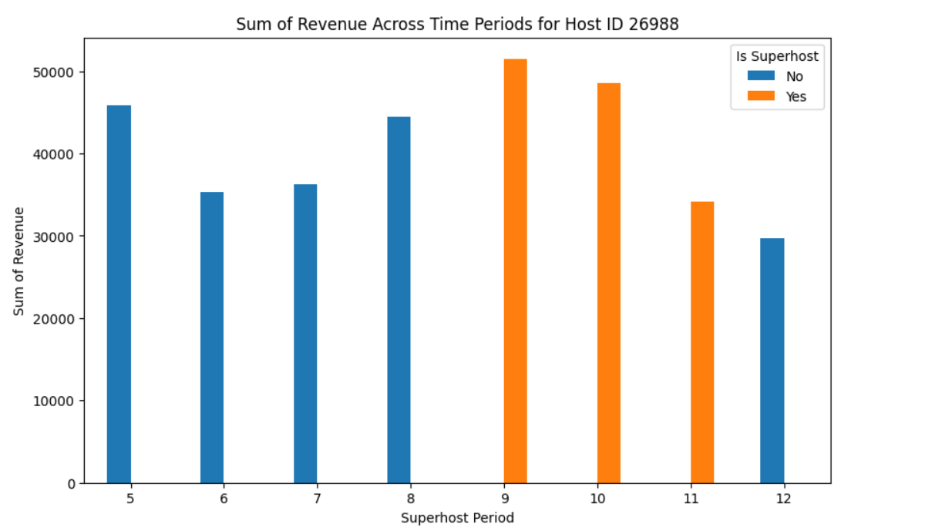
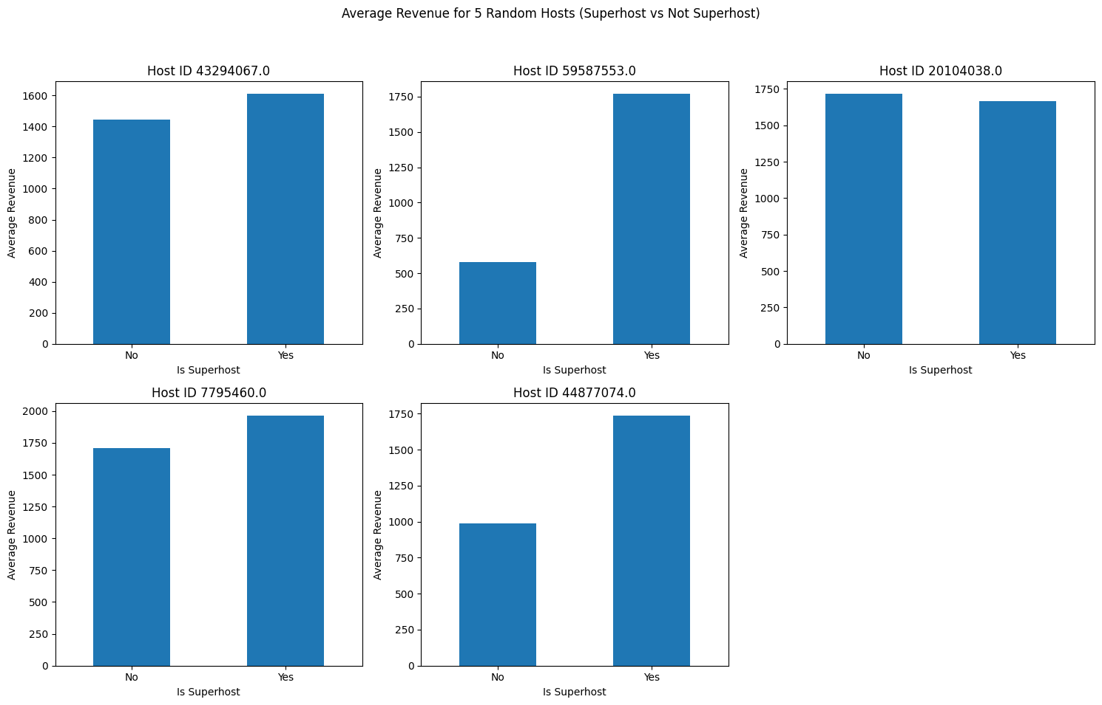
EDA (Exploratory data analysis)
Evaluation of superhost revenue trends with time.
Average Revenue for 5 random hosts (superhost vs not superhost).
Airbnb
Data Description
Business Problem 1
Business Problem 2
Future Scope & Conclusion

Slide 9
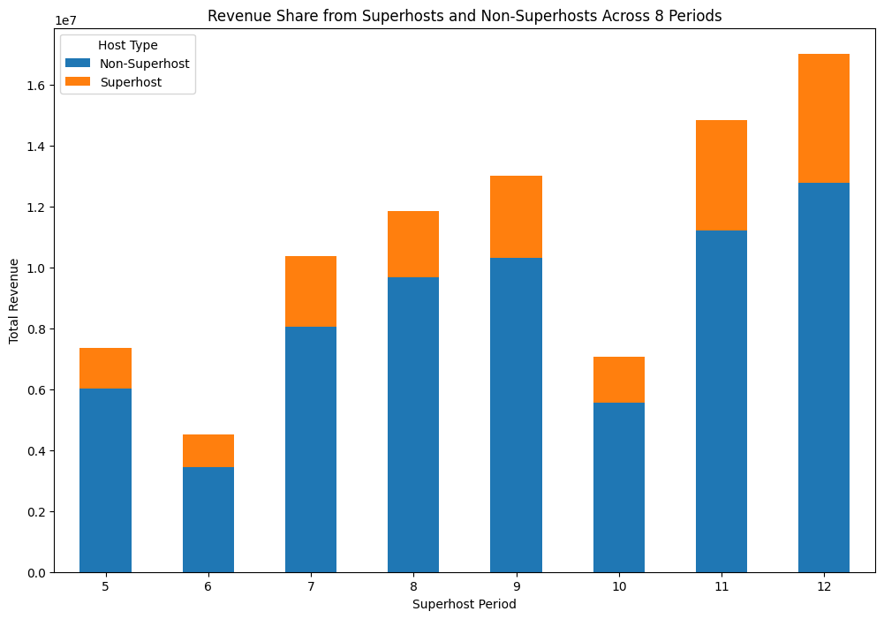
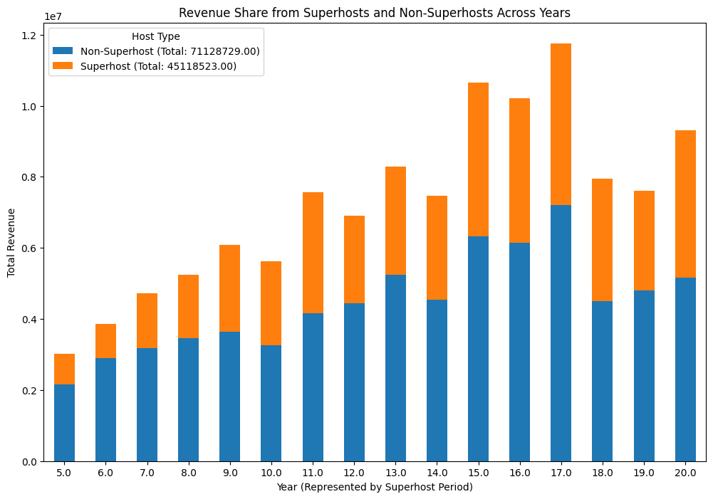
Evaluation of superhost revenue trends with time
Superhost period
Airbnb
Data Description
Business Problem 1
Business Problem 2
Future Scope & Conclusion

Slide 10
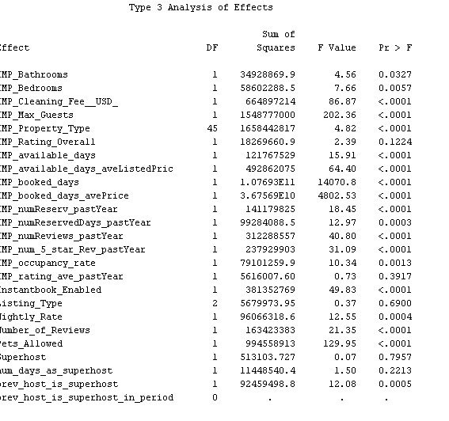
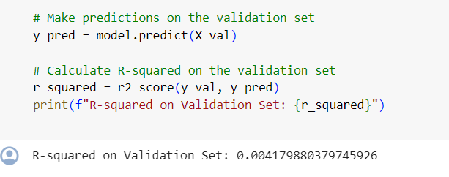
Revenue with respect to super host
Airbnb
Data Description
Business Problem 1
Business Problem 2
Future Scope & Conclusion

Slide 11
churn analysis
Factors affecting the churn of a superhost (based on the co-relation with respect to target variable revenue)
'account_age', 'numReviews_pastYear’, 'listings_per_host', 'avg_availability', 'avg_price’, 'prev_host_is_superhost', 'prev_year_superhosts'
Factors affecting the churn of a superhost (created factors)
df['listings_per_host'] = df.groupby('Airbnb HostID')['Airbnb Property ID'].transform('count')
df['avg_availability'] = df['available_days'] / df['listings_per_host']
df['avg_price'] = df['available_days_aveListedPrice'] / df['listings_per_host']
Airbnb
Data Description
Business Problem 1
Business Problem 2
Future Scope & Conclusion

Slide 12
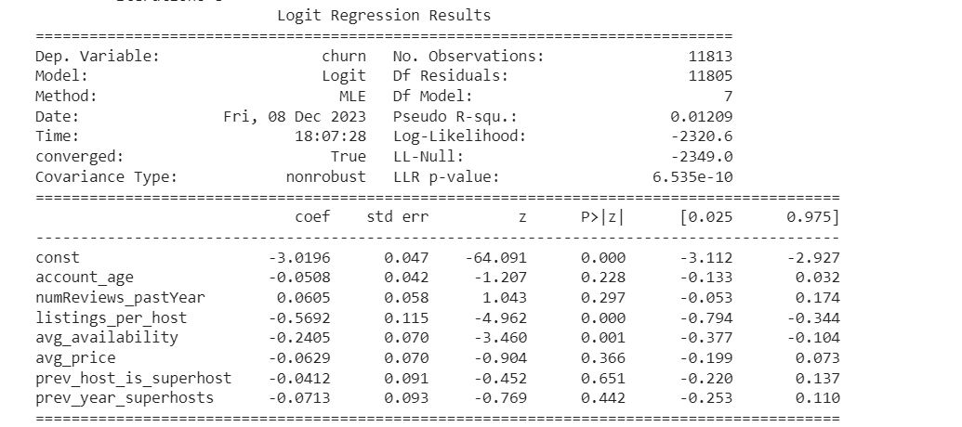
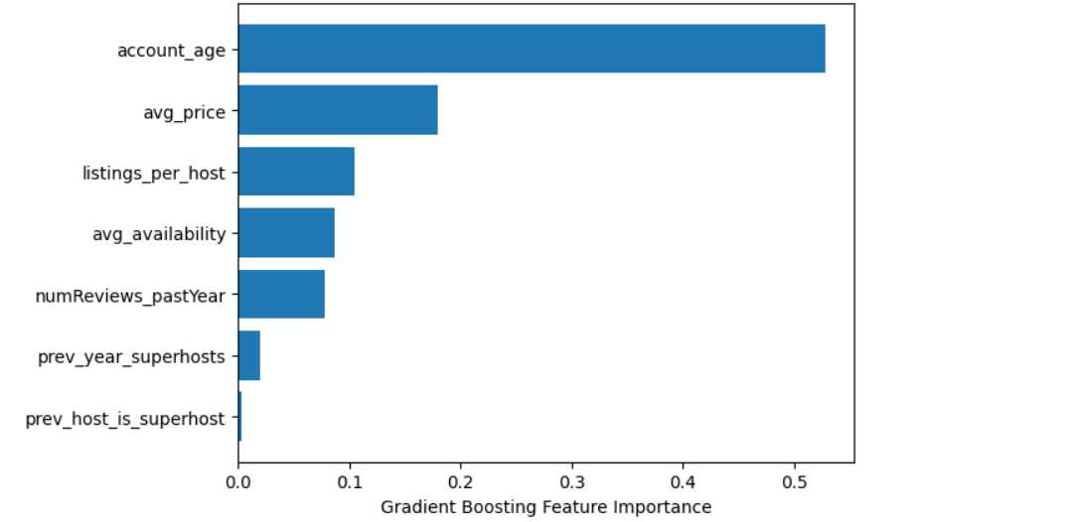
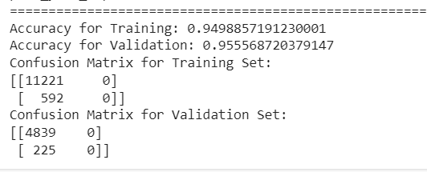
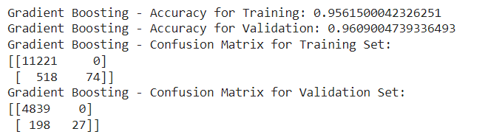
Factors affecting the churn of a superhost
Logit
Model
GB Model
Airbnb
Data Description
Business Problem 1
Business Problem 2
Future Scope & Conclusion

Slide 13
Business FINDINGS
No monetary incentive for being a super host.
Revenue is not being affected by superhost status.
So, there is good churn from superhost status.
Churn preventing factors are age of host, average listing price, average availability.
These indicate those who are hosts from long time are only not churning.
Airbnb
Data Description
Business Problem 1
Business Problem 2
Future Scope & Conclusion

Slide 14
Solution
Provide monetary value to superhost
Total Value = Willingness to pay – marginal cost - transactional cost
Transaction Cost
Marginal Cost
Willingness to Pay
Airbnb
Data Description
Business Problem 1
Business Problem 2
Future Scope & Conclusion

Slide 15
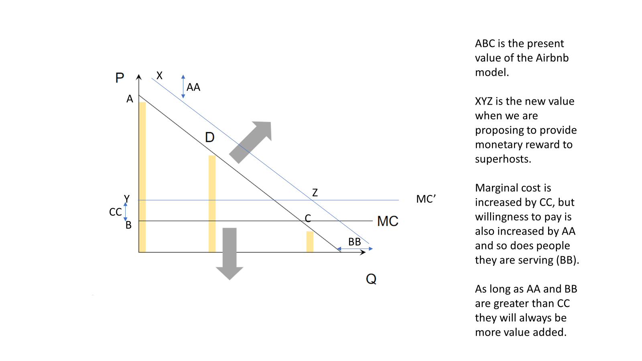
Solution Illustration
Airbnb
Data Description
Business Problem 1
Business Problem 2
Future Scope & Conclusion

Slide 16
Business Problem 2
Objective: To do a tract level analysis and finding the factors affecting the average bookings at tract level
Why this objective: To help Airbnb review bookings at broader level and provide suggestions to host on factors to improve.
Airbnb
Data Description
Business Problem 1
Business Problem 2
Future Scope & Conclusion

Slide 17
Pre-processing
Replaced categorical variables with mode of highest repeating class
Replaced interval variables with mean of the following values
Model 1: Linear regression
Model 2: Linear regression including polynomial terms with degree 2
To improve the model fit created polynomial regression which includes terms with degree 2.
Model Validation
Used a validation set and validated the development model.
Aggregated the data at tract level and took averages of the variables considered.
Created Avg_booking variable which represents the average price per booking in one particular tract.
Included all the given variables except ID.
Analyzed significance of individual variable
Only 'tract_count_obs' proved significant
Other interaction terms proved significant can be seen from the model output.
Only significant factors with significance level of 0.05 are considered
ANALYSIS FLOW
Business Problem 2
Business Problem 2
Future Scope & Conclusion
Business Problem 1
Future Scope & Conclusion
Data Description
Business Problem 1
Airbnb
Data Description
Airbnb

Slide 18
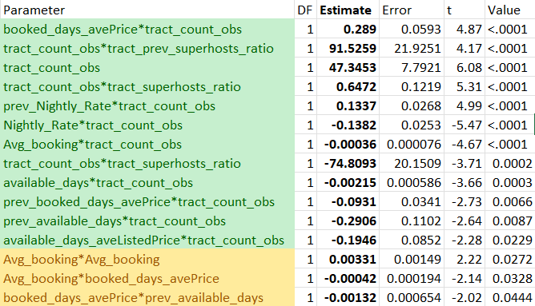
Significant variables
Business Problem 1
Business Problem 2
Future Scope & Conclusion
Airbnb
Data Description
Business Problem 3
Airbnb
Dataset Description
Business Problem 1
Business Problem 2
Conclusion

Slide 19

TAKEAWAYS
Number of hosts in the tract seems to be a very influential factor deciding the average number of bookings. They have a positive effect on the booking.
Interestingly, the interaction terms tract_super_host_ratio * tract_count_obs is negative. This term is nothing but number of superhosts. This has a negative effect on the average bookings.
Airbnb
Data Description
Business Problem 1
Business Problem 2
Future Scope & Conclusion

Slide 20
BUSINESS INSIGHTS
Airbnb can use this information to guide new and upcoming hosts to set up prices in a particular tract based on the factors like number of super hosts to pump up booking numbers.
The Herfindahl-Hirschman Index (HHI), can guide Airbnb's strategic decision-making by identifying market concentration levels, informing pricing strategies, and aiding new hosts in choosing less saturated areas for market entry.
Airbnb
Data Description
Business Problem 1
Business Problem 2
Future Scope & Conclusion
Notes:
If a new host want to list his property, from this he can get suggestions such as the tract selection and the price that can be put up.
As the analysis from Business problem 2 suggests that setting up in a tract which already have listings can be seen positive at first.
But after a point, the tract becomes overcrowded and any additional listing will effect negatively in the number of bookings. To solve that problem, we can use as HHI to gain further insights on tract selection.

Slide 21
Future Scope
The model and solution implemented can be extended to the host level, allowing for the prediction of optimum pricing based on various factors related to the hosts and the characteristics of the tract in which their listings are located.
If implemented by Airbnb, this approach would enable hosts to receive an optimum suggested price that maximizes their number of bookings, allowing them to effectively regulate their listing prices based on this recommendation.
Airbnb
Data Description
Business Problem 1
Business Problem 2
Future Scope & Conclusion
Notes:
In the regression equation, by keeping all the remaining predictors constant for one particular host, vary average booking price from zero to infinity and see how number of bookings being varied w.r.t to that. We can find for a particular price point there will be maximum number of bookings.

Slide 22
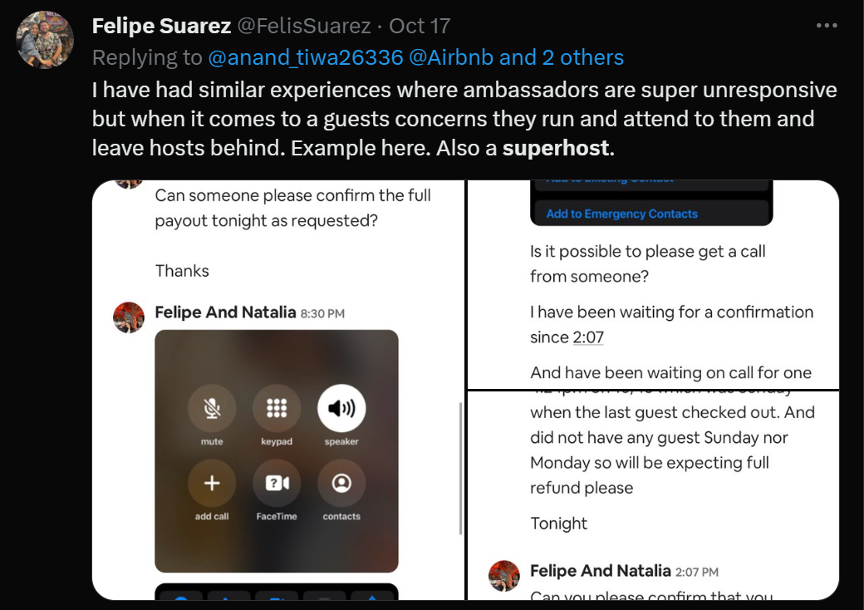
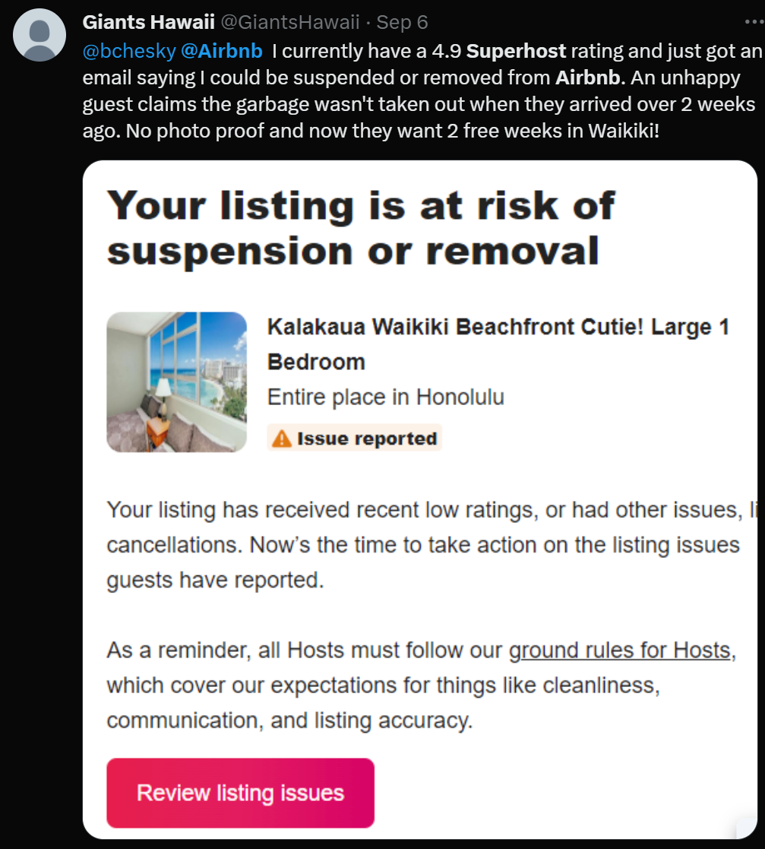
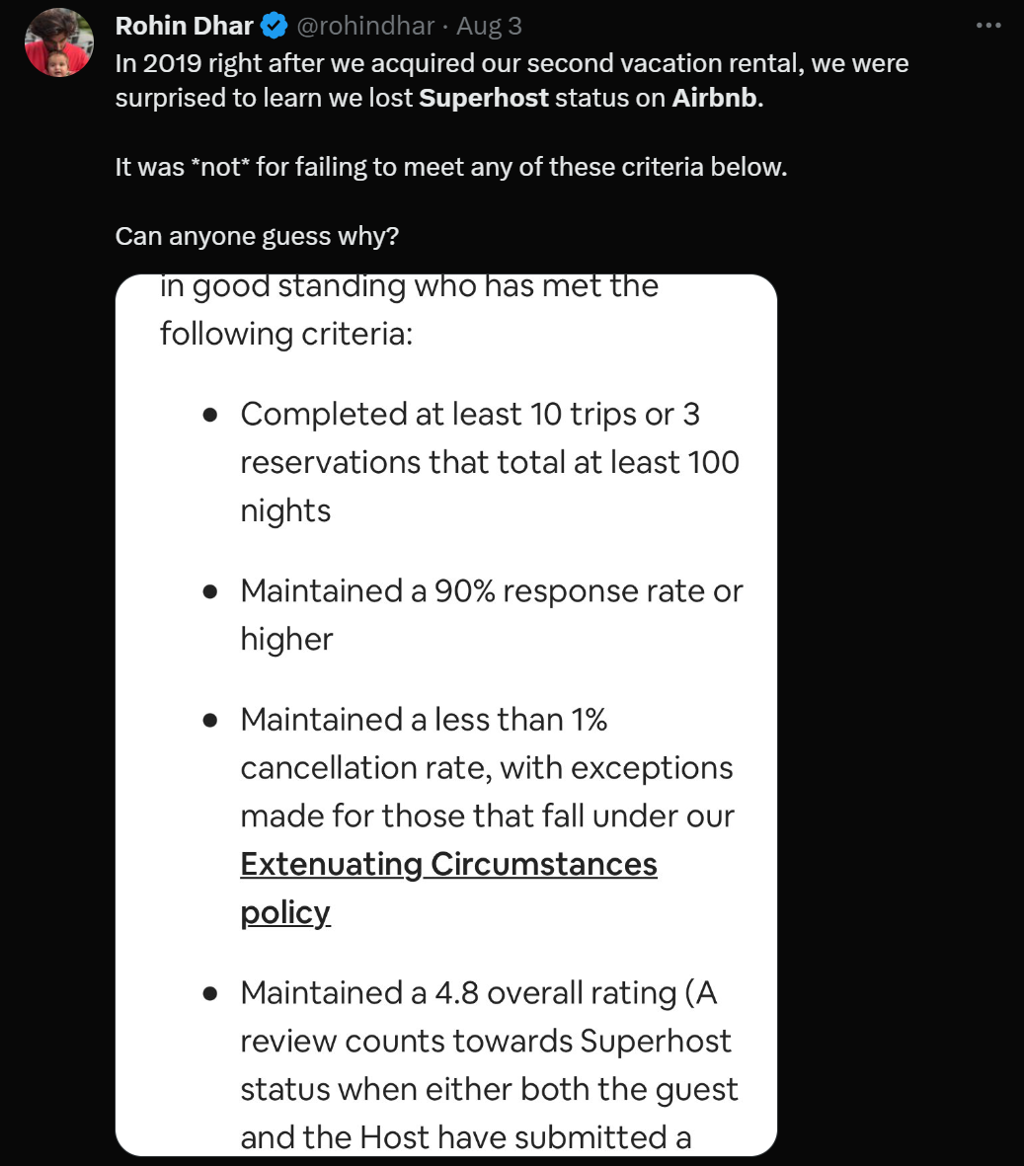
PUBLIC PULSe
Airbnb
Data Description
Business Problem 1
Business Problem 2
Future Scope & Conclusion
Notes:
Some snippets of hosts being not happy with airbnb.
Especially even very less number of negative reviews can make airbnb withdrew superhost status.

Slide 23
conclusion
Airbnb should consider offering monetary benefits to encourage hosts to become superhosts, as this could increase consumers willingness to pay and lead to a higher number of bookings due to improved service quality.
Airbnb should think of making this superhost criteria bit more flexible and less generic.
The Superhost criteria do not seem to be aiding in increasing the number of bookings (business problem 2) nor are they providing benefits at the individual host level (business problem1)​
Airbnb
Data Description
Business Problem 1
Business Problem 2
Future Scope & Conclusion
Notes:
The superhost model can be changed to make it more transparent.
As can be seen above there are no significant advantages for being a superhost.
They should find some way to incentivize hosts to become superhosts.
Our solution is to give monetary advantage, which may hit profits of airbnb for a brief time, but because of that number of hosts will be increased. Which will inturn increase number of customers

Slide 24
References
Alyakoob, Mohammed, and Mohammad Rahman. "Airbnb: Is it a curse or a blessing for restaurant employment." (2018).
Alyakoob, Mohammed, and Mohammad S. Rahman. "Shared prosperity (or lack thereof) in the sharing economy." Information Systems Research 33.2 (2022): 638-658.
https://www.theguardian.com/money/2019/dec/21/my-airbnb-superhost-stay-turned-into-a-super-disaster
https://community.withairbnb.com/t5/Ask-about-your-listing/Is-Superhost-status-worth-the-angst-of-trying-to-keep-it/m-p/1833624
Airbnb
Data Description
Business Problem 1
Business Problem 2
Future Scope & Conclusion
Notes:
The superhost model can be changed to make it more transparent.
As can be seen above there are no significant advantages for being a superhost.
They should find some way to incentivize hosts to become superhosts.
Our solution is to give monetary advantage, which may hit profits of airbnb for a brief time, but because of that number of hosts will be increased. Which will inturn increase number of customers

Slide 25
Thank you

